Slide 1

Restaurant Predictor
Aria Askaryar
&
Akshay Sakpal

Slide 2



Topic and Summary
Descriptive and Predictive Data Analysis of Open Source Restaurant Data
The primary aim is to utilize machine learning algorithms to extract valuable insights from data and forecast the likelihood of a new restaurant's success.

Slide 3







Tools
Python (Pyspark, Pandas, Numpy, matplot)
Streamlit
Machine Learning scikit-learn
Zomato dataset: https://www.kaggle.com/datasets/himanshupoddar/zomato-bangalore-restaurants
Algorithms Linear Regression

Slide 4
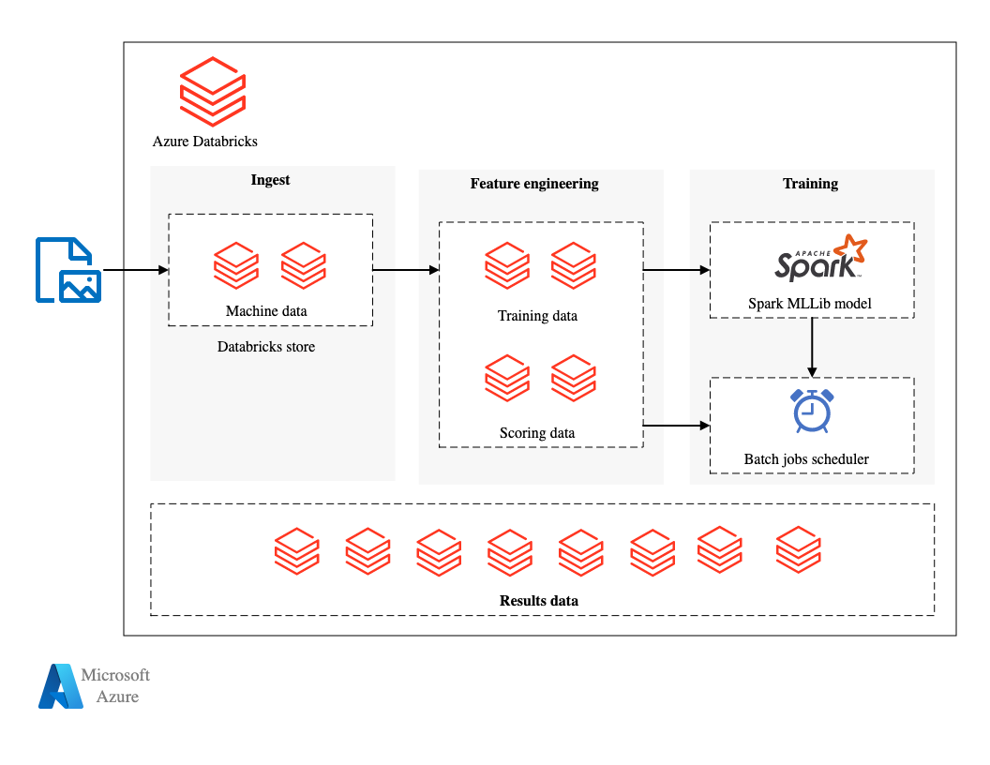
Hadoop and Databricks
Using Databricks file system built on top of Hadoop, Databricks which does the data portioning for us
Provides cluster for running which uses Apache spark and Scala
Nearest zone for clusters works similarly to AWS

Slide 5
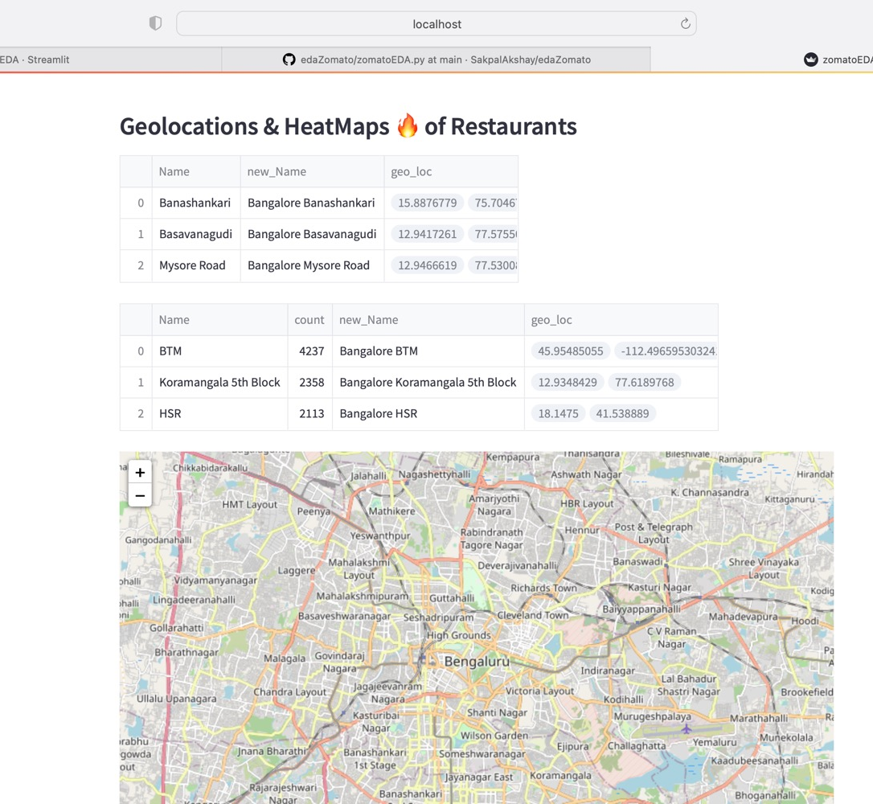
Geolocations & HeatMaps
Utilizing a API to give exact geo location
Nominatim

Slide 6
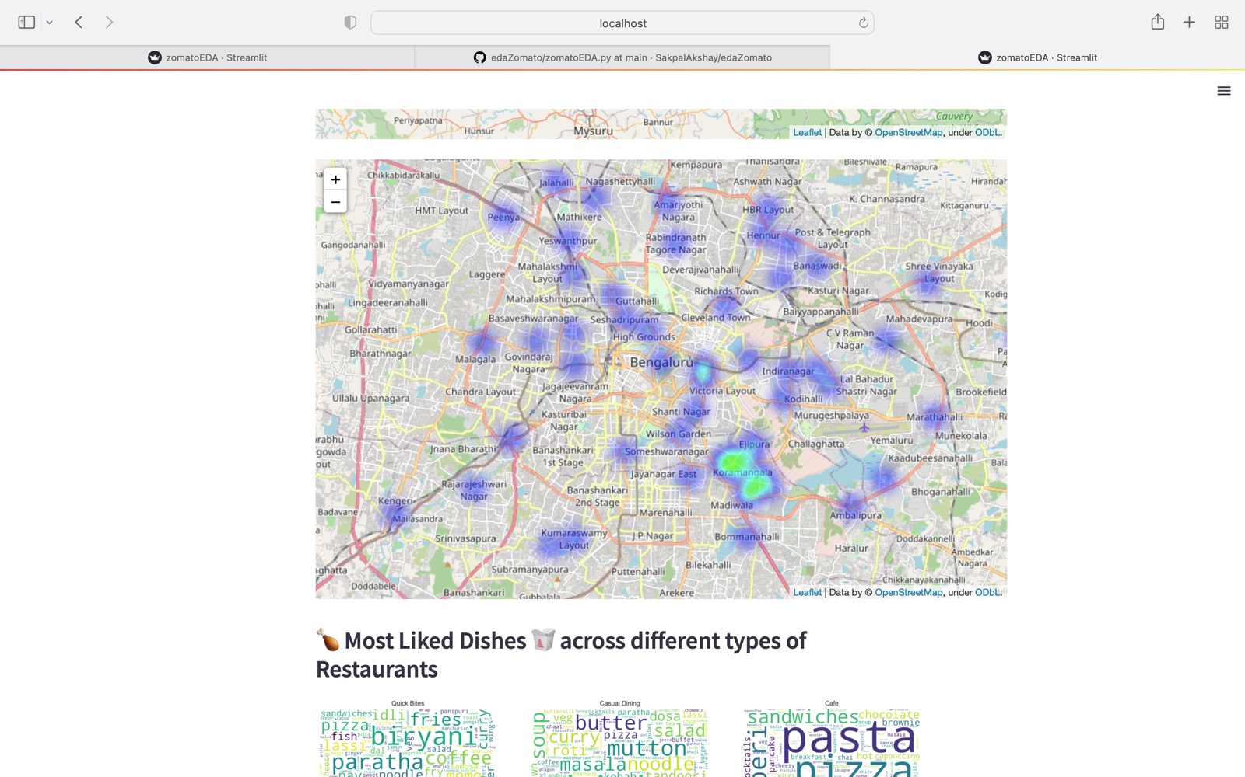

Slide 7
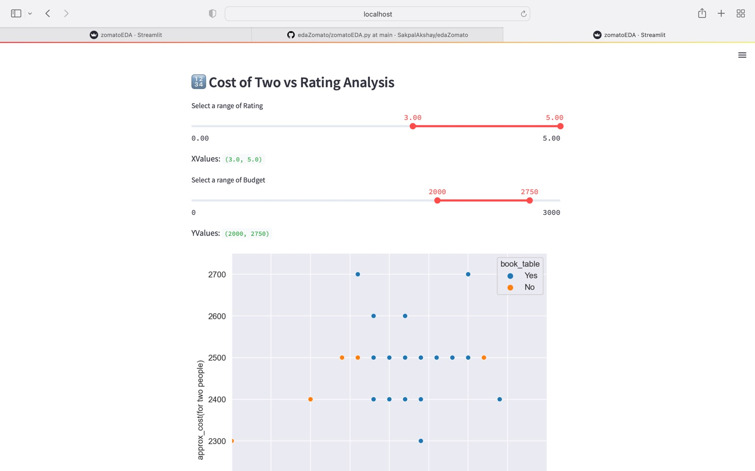

Slide 8
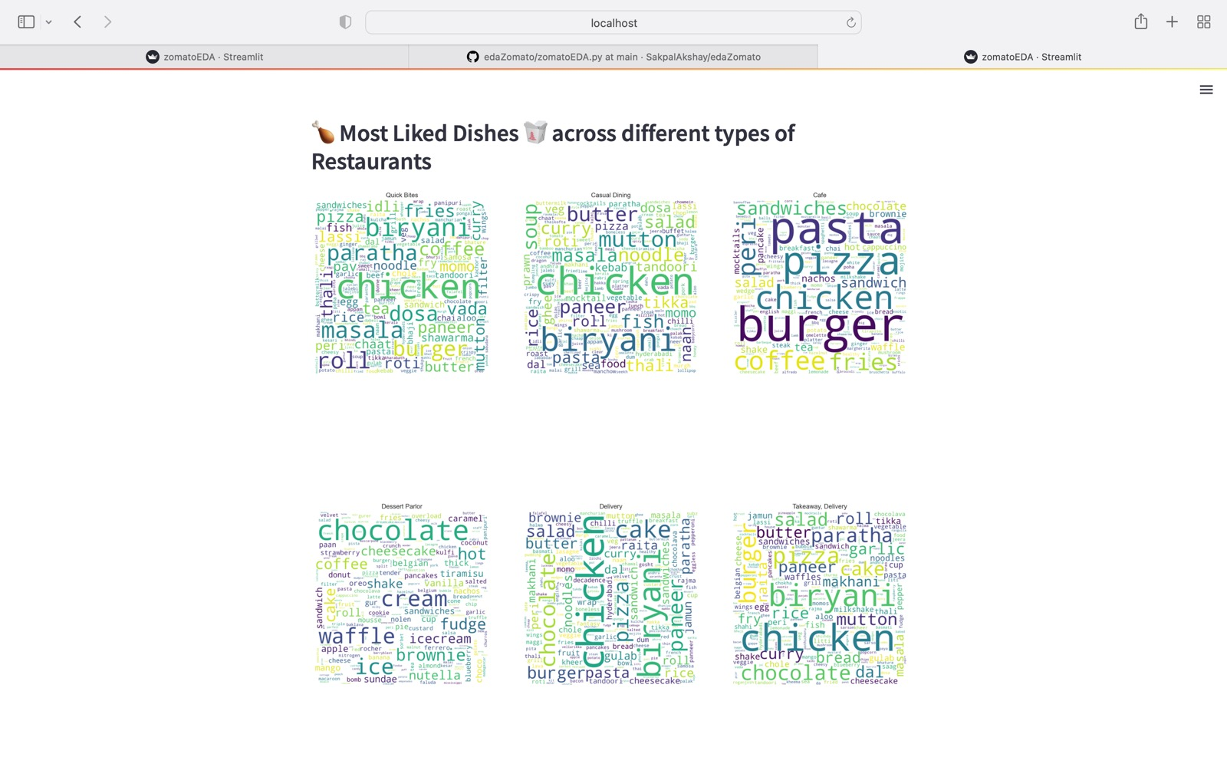

Slide 9
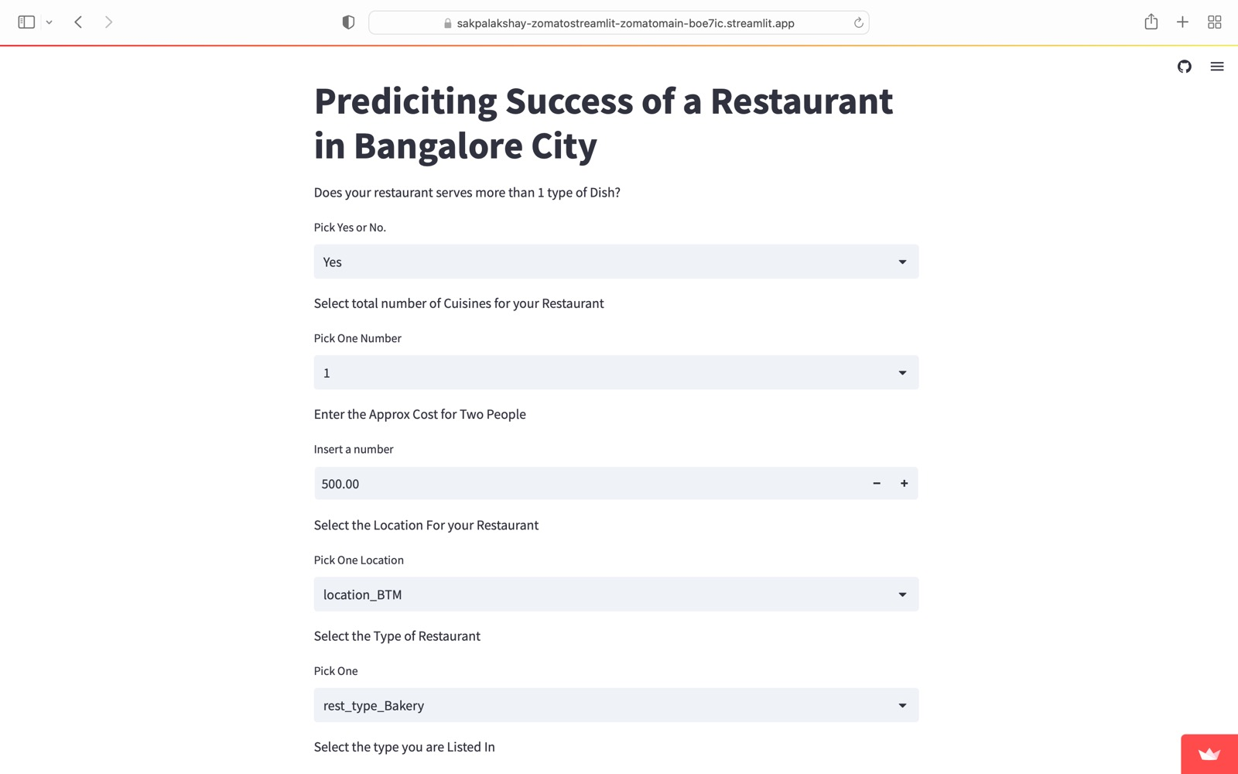
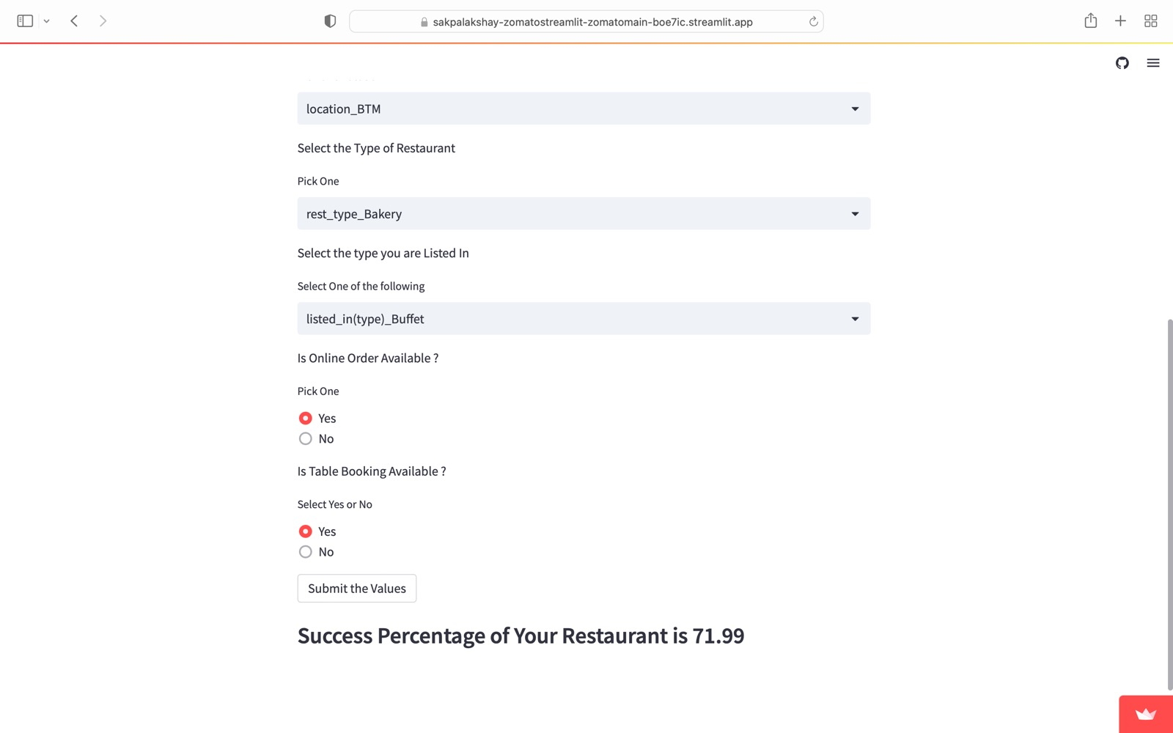

Slide 10
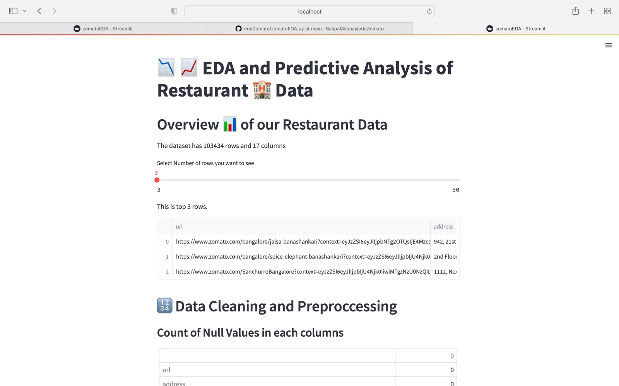

Slide 11
Training Data and Testing Data

Slide 12
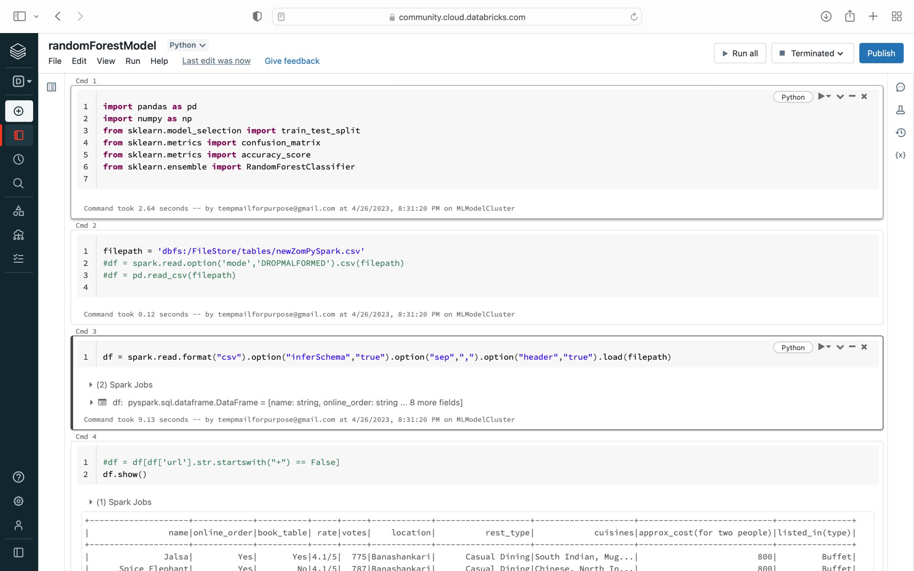
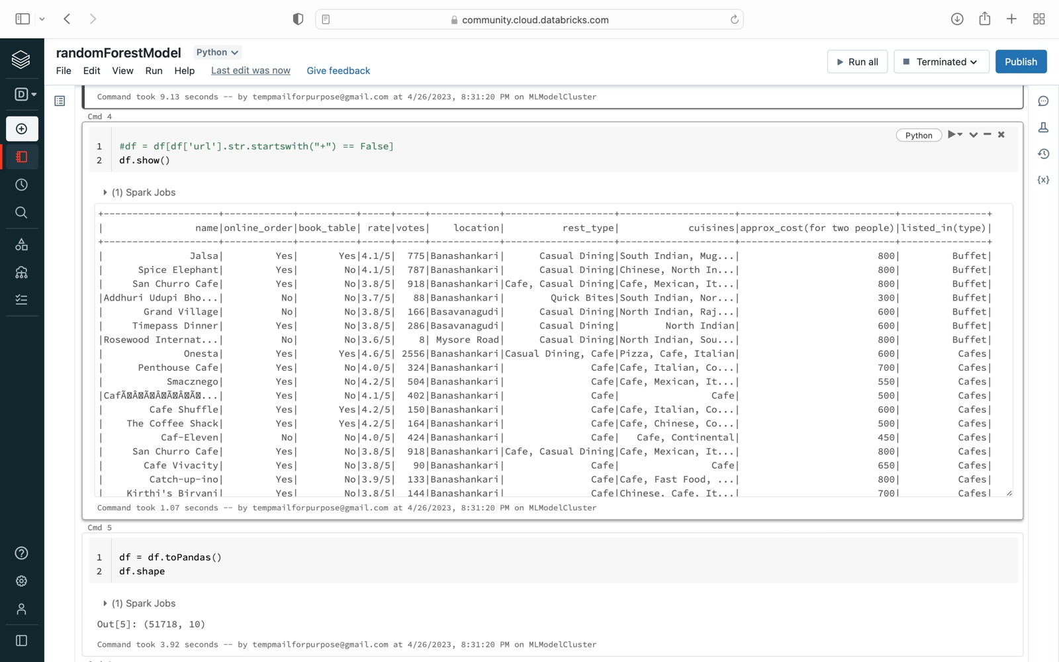

Slide 13
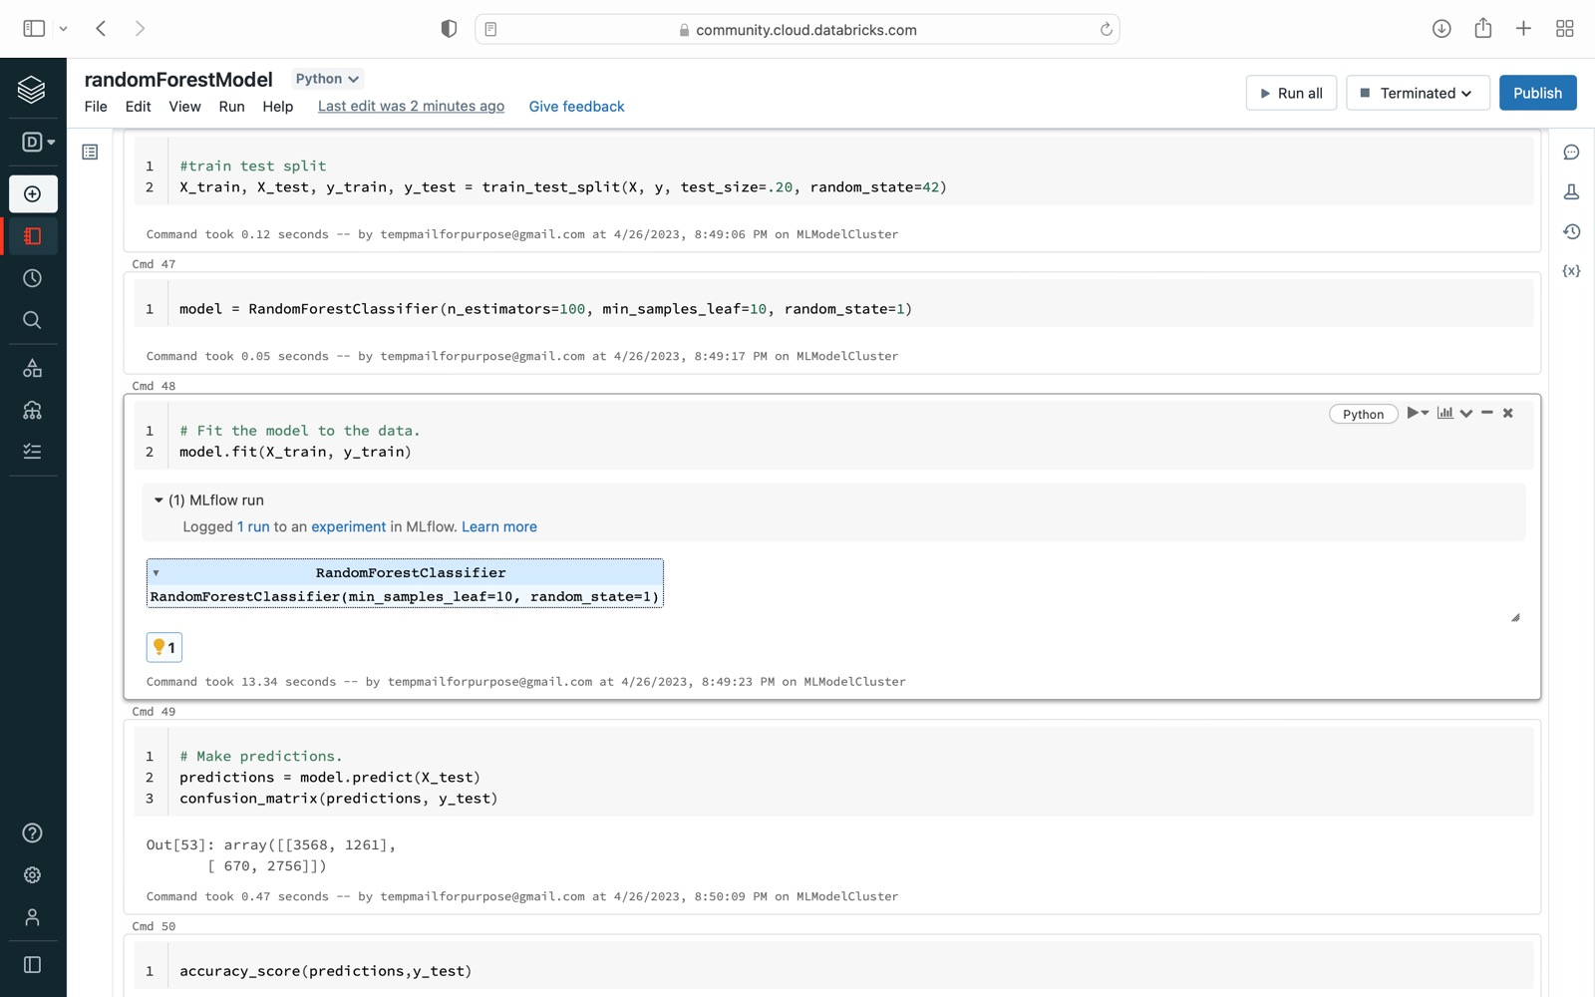
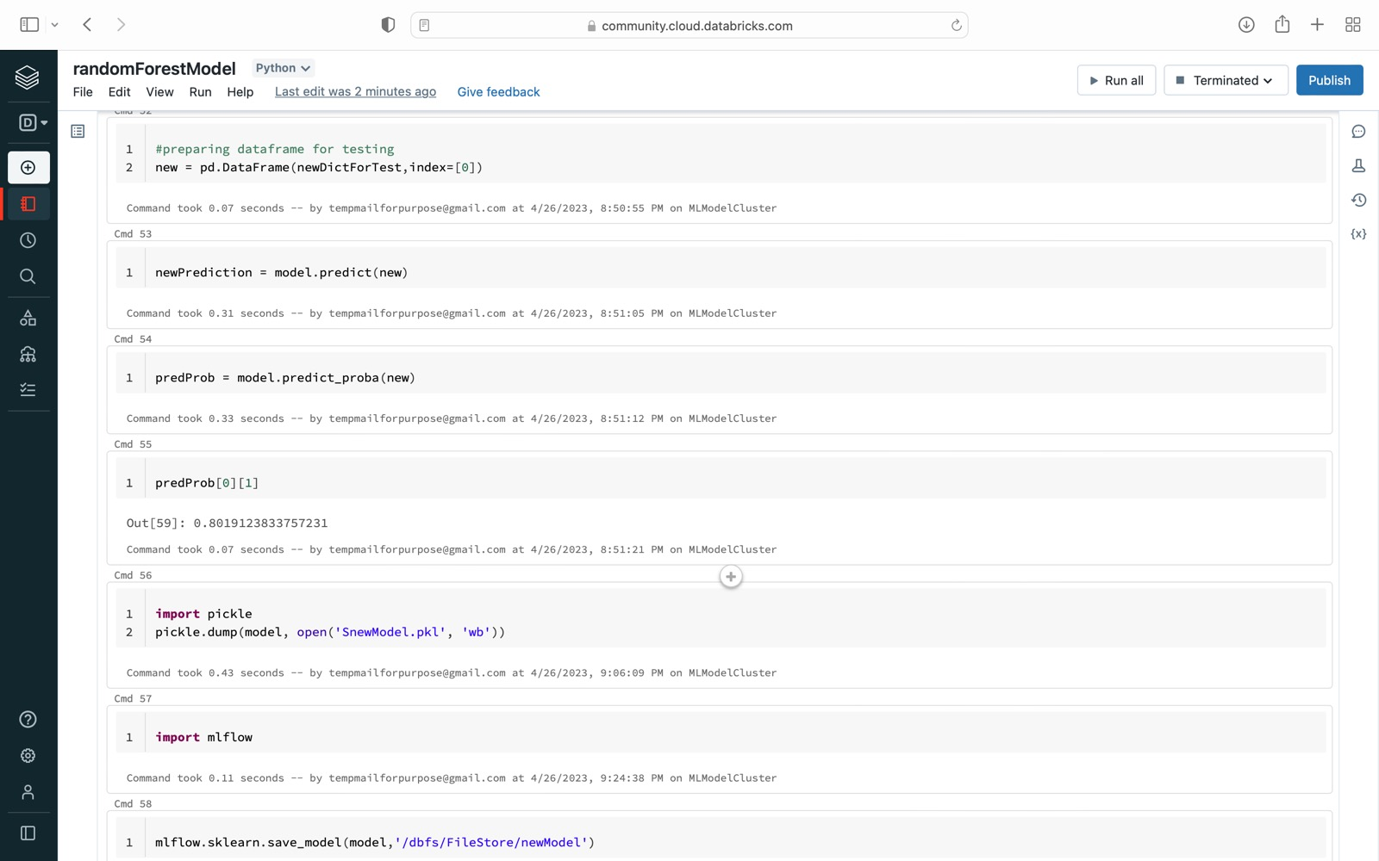

Slide 14
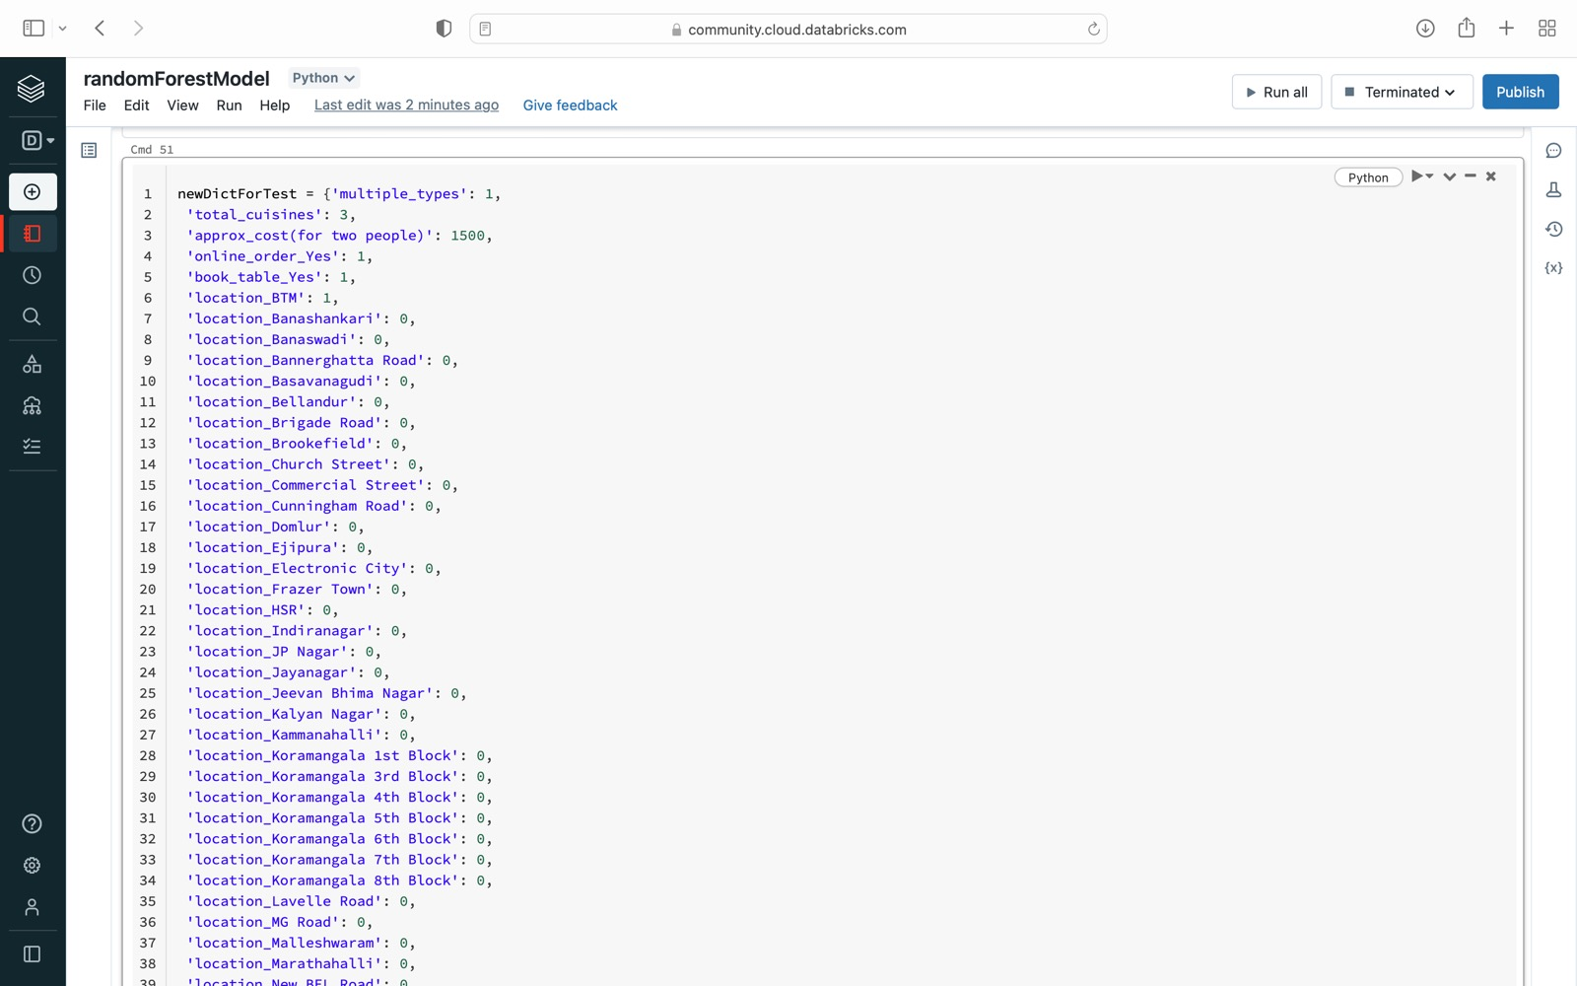

Slide 15
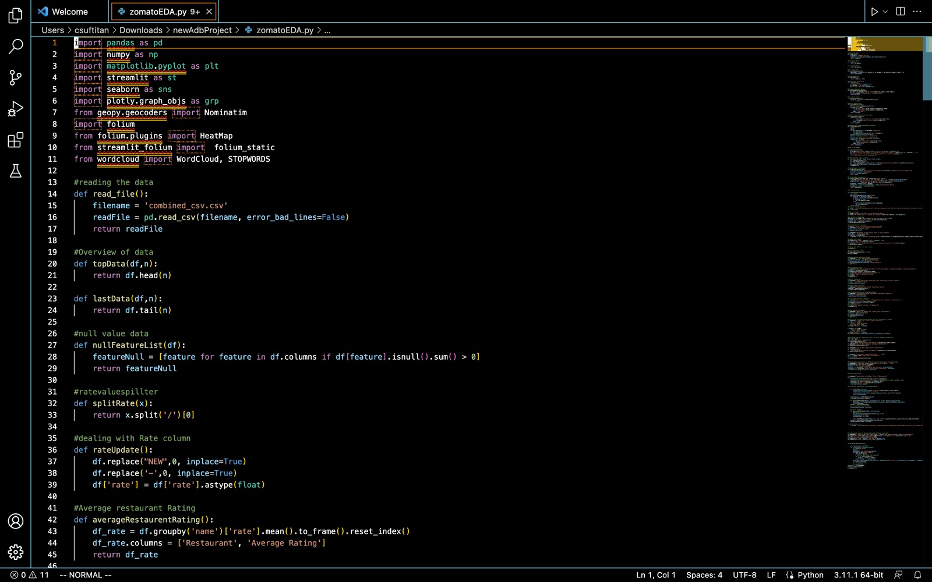
Subtitle

Slide 16
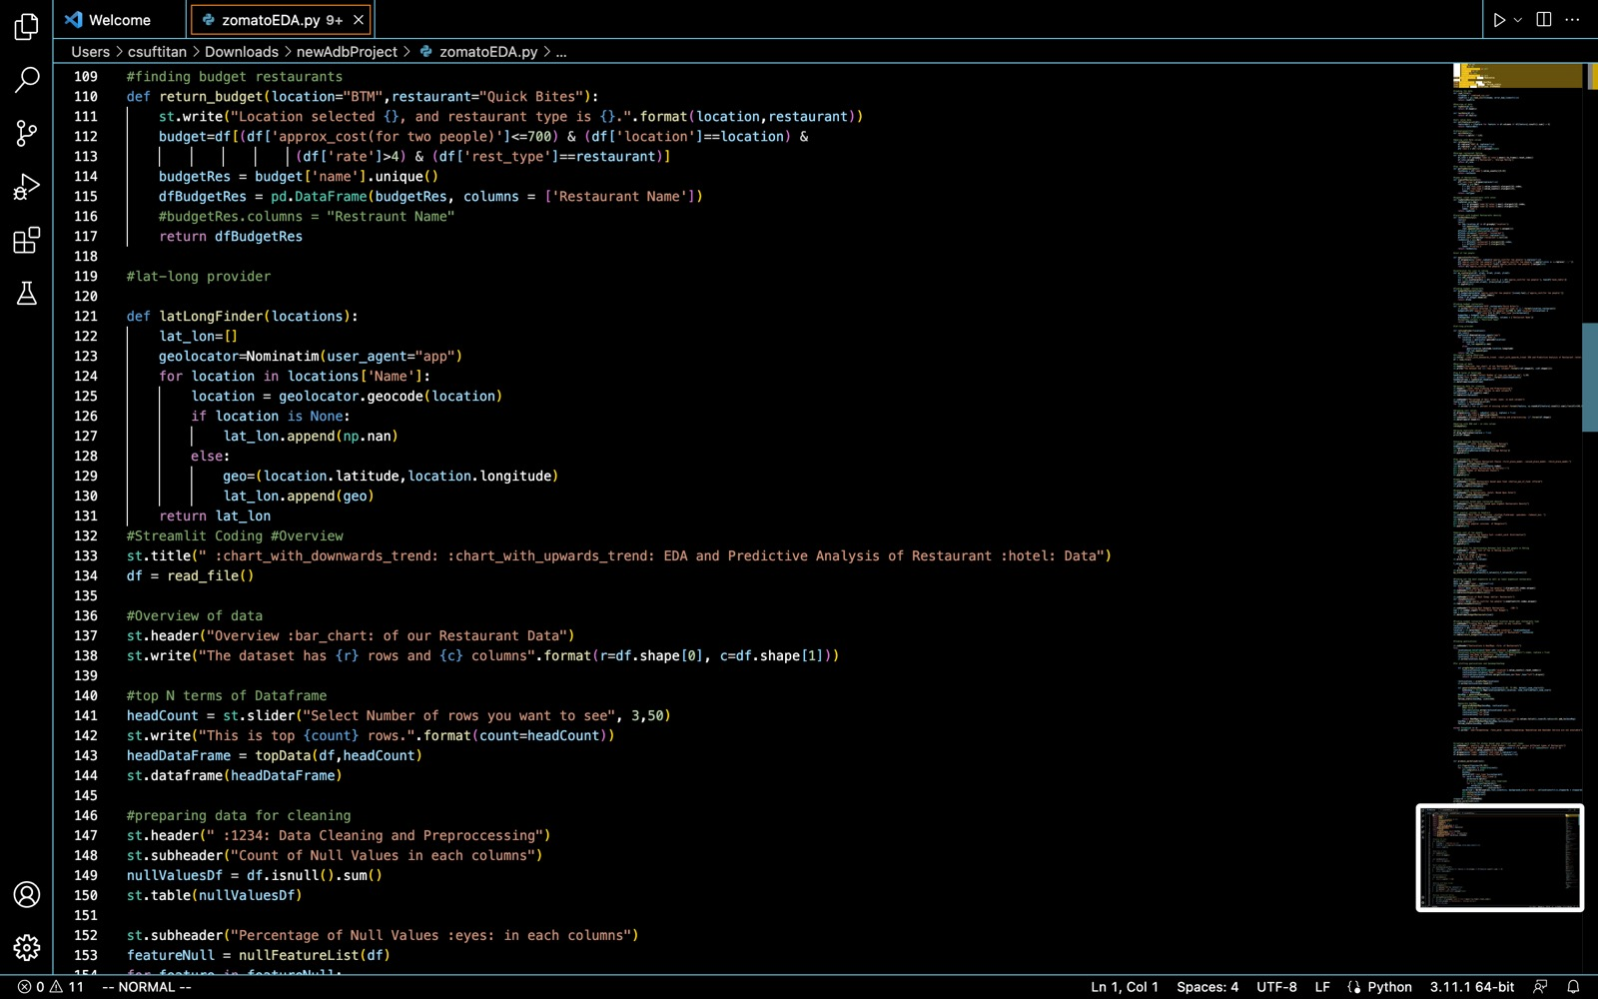

Slide 17
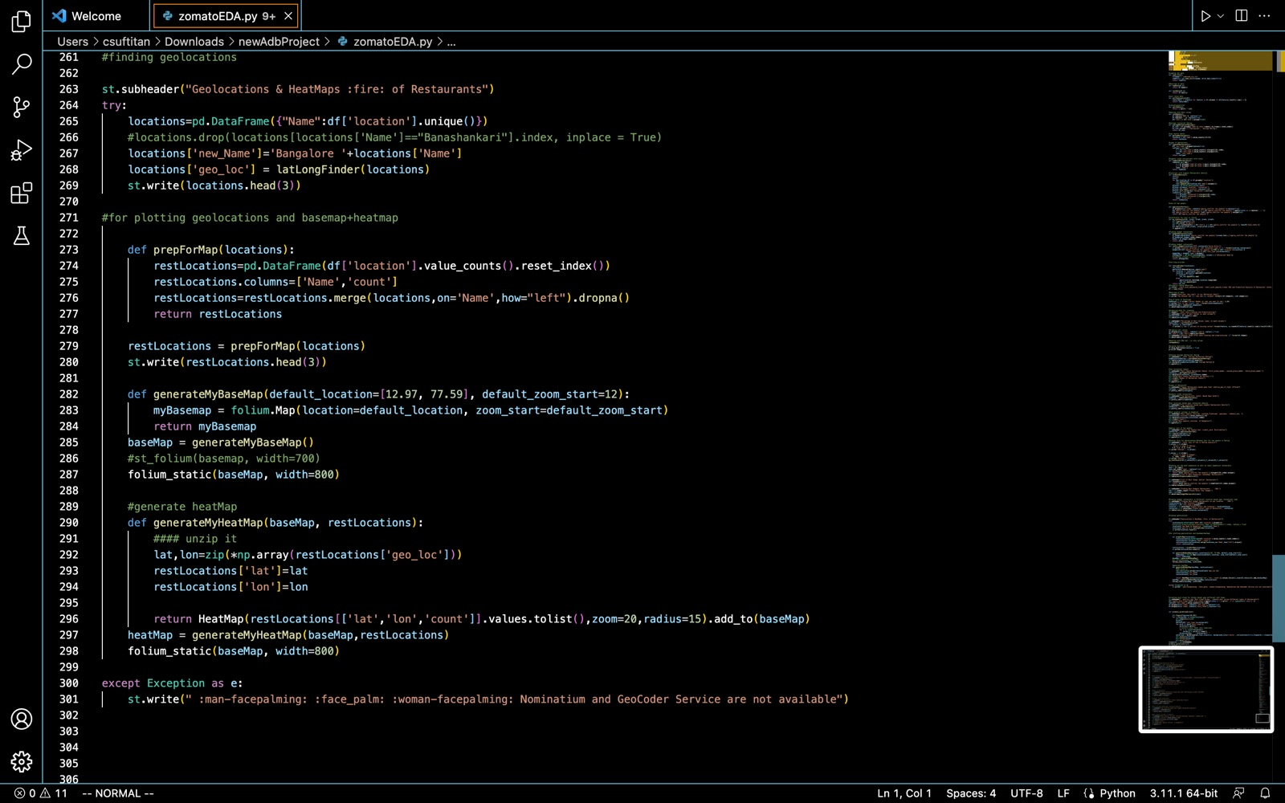

Slide 18
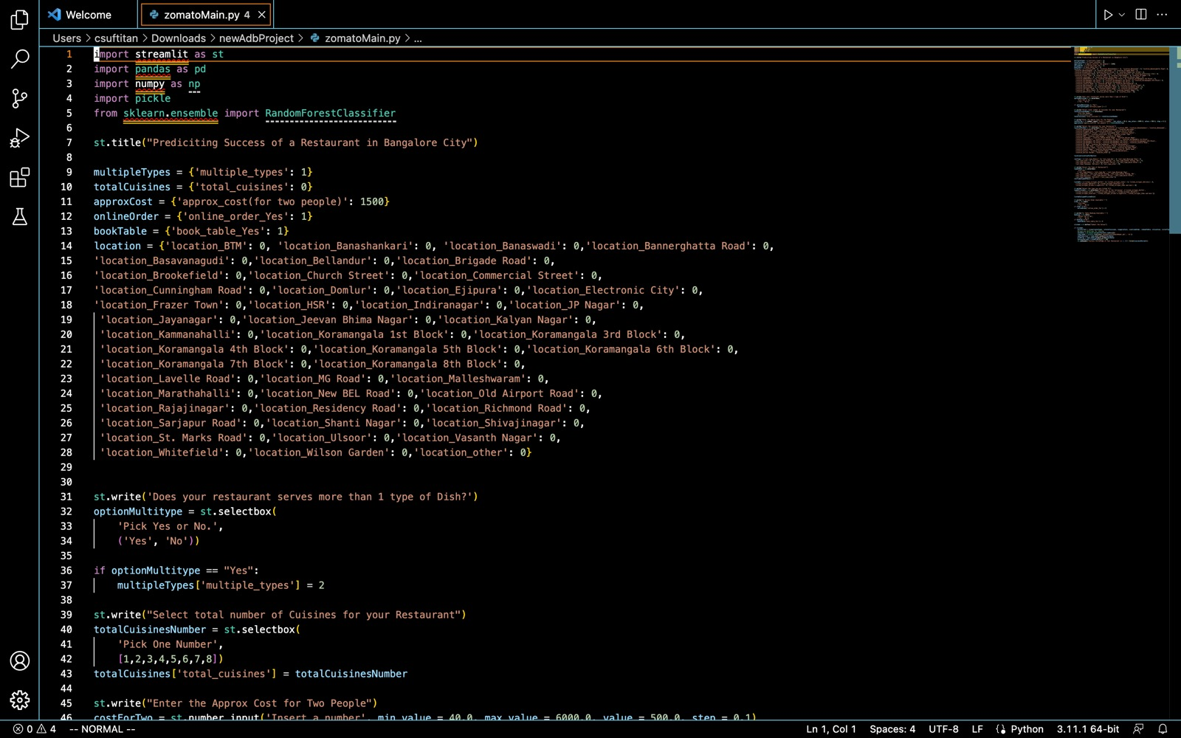

Slide 19
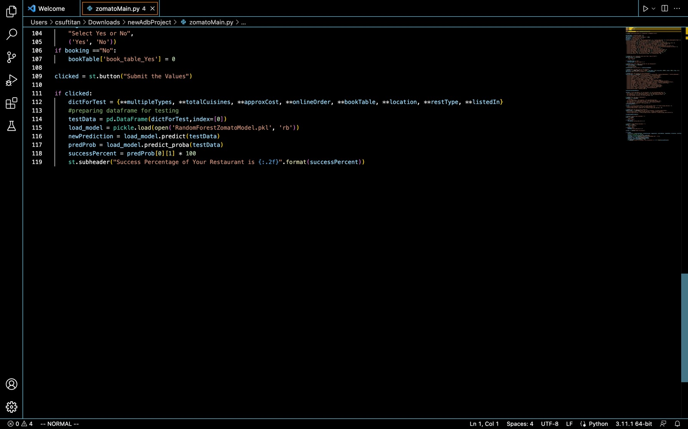

Slide 20
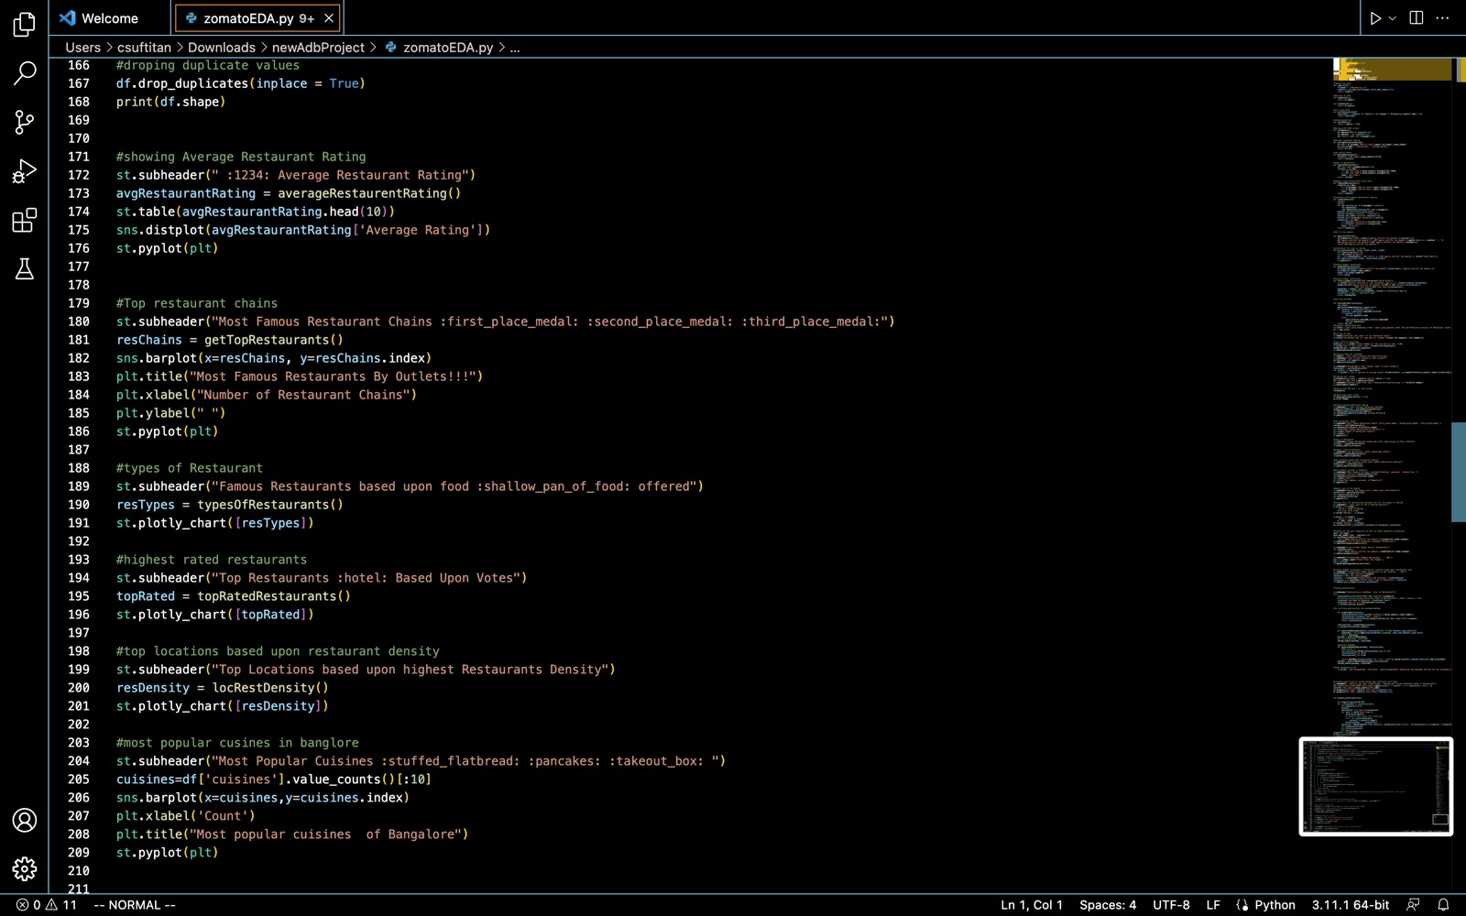

Slide 21
Demo
https://sakpalakshay-zomatostreamlit-zomatomain-boe7ic.streamlit.app

Slide 22

Summary
Our ML model is making predictions of how likely a restraint will be successful based on geographical location and cuisine type.

Slide 23



Thank You
Any Questions?

